Slide 1
Industrial Automation Security
April 6th, 2011
Oliver Niedung
Microsoft OEM EMEA Embedded Server

Slide 2
Agenda
Today’s Security Challenge
Securing current Windows Embedded based Automation Systems
Managing security in modern Windows based Automation System environment
How to benefit from Cloud Computing in securing Automation Systems
Q&A

Slide 3
Before we start
What are the questions that you would like to get answered today?
Introduction

Slide 4
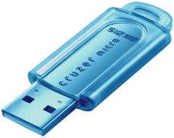
Today’s IT Security Challenges
Today’s Challenges
Personal info online
Need 24/7 uptime
Consumerization
of IT
Viruses and worms
Botnets and rootkits
Information loss/leakage
Phishing and fraud
Regulatory compliance
Corporate policies
Unauthorized access
Spyware
Patch management
Unmanaged PCs
Spam
Inappropriate content

Slide 5
Threat Trends to Date
Exponential Growth of IDs Identity and access management challenging
Increasingly Sophisticated Malware Antimalware alone is not sufficient
40%
35%
30%
25%
20%
15%
10%
5%
0%
Changing mix of malicious and potentially unwanted software
B2C
35.3%
32.3%
B2E
B2B
29.5%
29.9%
mobility
24.0%
24.2%
Number of Digital IDs
19.6%
20.8%
Source: Microsoft Security Intelligence Report (January – June 2007)
Internet
13.1%
18.0%
12.7%
13.3%
11.4%
client/server
5.3%
3.1%
6.0%
6.1%
mainframe
1.0%
.6%
Pre-1980s
1980s
1990s
2000s
2010
3Q09 4Q09 1Q10 2Q10
Crime on the Rise
Attacks Getting More Sophisticated Traditional defenses are inadequate
National Interest
Largest segment by
$ spent on defense
Examples
Spyware
Rootkits
Application attacks
Phishing
Social engineering
Spy
User
Largest area by
$ lost
Personal Gain
Thief
Fastest
growing
segment
GUI
Applications
Personal Fame
Trespasser
Drivers
O/S
Vandal
Largest area by volume
Author
Hardware
Curiosity
Physical
Script-Kiddy
Amateur
Expert
Specialist
Slide 3 of 16

Slide 6
Industrial Automation security challenge
Protection
Access
Identity
Management
High number of security threats (Viruses, worms, intrusions, ...) also in automation environments. Stuxnet.
Long term availability of industrial automation solutions (lifecycle) & availability of patches.
More connectivity between manufacturing and business networks → process insights.
Ongoing management of users, devices, configurations, patches.
Increasing knowledge required for IT security and administration.
Industry specific: Often a requirement to keep production going even when system is compromized.

Slide 7
Is this a Microsoft specific problem?
Microsoft acknowledges high responsibility as a result of the broad installed base.
This clearly is a software industry problem. Secunia 2010 Half Year Report:
The overall conclusion is that despite considerable security investments, the software industry at large still proves unable to produce software with substantially less vulnerabilities, highlighting the continued need for Vulnerability Intelligence and Patch Management.
Further, the report shows an alarming development in 3rd party program vulnerabilities, representing an increasing threat to both users and business, which, however, continues to be greatly ignored. This trend is supported by the fact that users and businesses still perceive the operating system and Microsoft products to be the primary attack vector, largely ignoring 3rd party programs, and finding the actions to secure these too complex and time-consuming. Ultimately this leads to incomplete patch levels of the 3rd party programs, representing rewarding and effective targets for criminals.
In the two years from 2007 to 2009, the number of vulnerabilities affecting a typical end-user PC almost doubled from 220 to 420, and based on the data of the first six months of 2010, the number is expected to almost double again in 2010 to 760.
A typical end-user PC with 50 programs installed had 3.5 times more vulnerabilities in the 24 3rd party programs installed than in the 26 Microsoft programs installed. It is expected that this ratio will increase to 4.4 in 2010.

Slide 8
Microsoft Mission – Industrial Solutions
Reduce Time-to-Market and cost
Increase End-Product reliability
Reap the benefits of application compatibility
Long-term availability and support
To thrive in today’s economy, factories and plants that produce manufactured goods, oil, gas, food, and pharmaceuticals must run at the highest efficiency while ensuring flawless quality.
This requires total infrastructure and management control—from Sensors to Servers. Windows® Embedded integrated solutions from Microsoft provide that foundation for control by supporting the entire process and by helping to reduce time-to-solution, increase plant reliability, and lower production costs.

Slide 9
Your and your vendors benefits Microsoft Embedded
Fast time-to-market
Broad ecosystem of partners
Many partners to chose from
Rich applications
Product support
Long lifecycle
High ROI (return on invest)
Easy and powerful management (System Center)
Easier to find experienced administrators
Less training required
System Reliability
End-to-End solutions

Slide 10
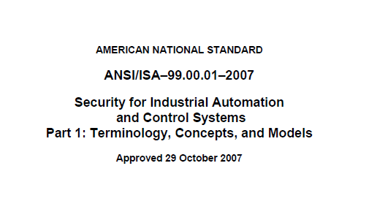
ISA 99
ANSI Standard: Security for Industrial Automation
Most industrial automation vendors are members

Slide 11
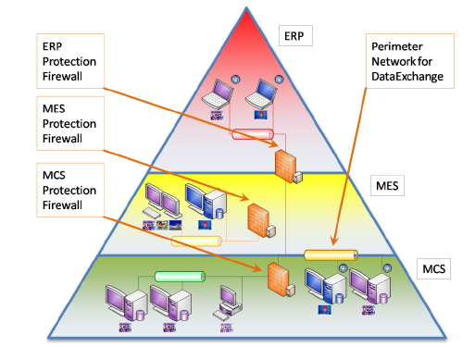
Example: Siemens Security Concept
MES – Manufacuting Execution System (Produktionsplanung)
MCS – Manufacturing Control System (Automatisierungsebene)

Slide 12
Securing current Industrial Systems
Awareness
General staff security training and secure processes, e.g. password, no USB key access
Ask your vendor for their security concept and how it can be implemented in your current environment.
Active Protection
Network segmentation:
Avoid exposure of the Manufacturing systems to the internet.
Hide Manufacturing sytems from business networks.
Example: Microsoft Threat Management Gateway Appliance from SecureGUARD
Clients
Antivirus tools, e.g.
Microsoft Security Essentials (MSE)
Forefront Endpoint Protection
Unified patching
Patch management tools (e.g. System Center) and processes – for all applications and operating systems.
Good website: http://www.slideshare.net/JohnCusimano/first-things-first

Slide 13
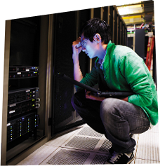
Trustworthy Computing: Working Toward a Safer, More Trusted Internet
Business
Security
Privacy
Reliability
Practices
Secures against attacks
Protects confidentiality, integrity, and availability of data and systems
Helps manage risk
Protects from unwanted communication
User choice and control
Products, online services adhere to fair information principles
Dependable, available
Predictable, consistent, responsive service
Maintainable
Resilient, easily restored
Proven, ready
Commitment to customer-centric interoperability
Recognized industry leader, world-class partner
Open, transparent
SQL Server® 2005
Visual Studio® 2005
Malicious SW Removal Tool
Windows Server 2008
SQL Server 2008
End-to-End Trust
Microsoft Security Essentials
Windows 7
Windows Azure
Microsoft Security Essentials v2
U-Prove
Office 365
Trustworthy Computing announced;
SDL begins
Windows Defender
Windows Live® OneCare
Windows® XP SP2
DSI Launched
Windows Vista®
Office 2007
Forefront®
Windows Server® 2003
2002
2003
2004
2005
2006
2007
2008
2009
2010
Notes:
Since the Trustworthy Computing Initiative was introduced in early 2002, Microsoft has been working wholeheartedly to address security issues in both our software and in the industry.
Broadly adopted technologies such as telephony and electricity have become trusted parts of our daily lives. Even though they occasionally fail, the overwhelming perception is that these technologies are inherently trustworthy. Achieving similar confidence in technology reliability is a fundamental objective of the Microsoft Trustworthy Computing initiative.
The challenge: While the overall quality of technology has improved considerably, customer expectations for end-to-end reliability outpaced these improvements. Compounding the challenge is the increasing complexity of software and the computing ecosystem, plus the lack of real standards for measuring reliability. Microsoft has a vision of seamless computing, in which all types of devices work easily together as if they were all a single device. For Microsoft to make that vision real, we focus on our four pillars of Trustworthy Computing.
First is Security
Microsoft takes a defense-in-depth approach to security and is aligning around three core elements:
Fundamentals
The focus on fundamentals is making the platform inherently safer. As part of this initiative Microsoft has trained its developers, testers, and program managers in how to develop more secure code, putting in place a process for developing secure code.
Another key area of the Microsoft approach is enhancing the process and tools used in updating customer software. Microsoft has been and will continue to work hard to make the updating process more manageable by making it predictable, improving the quality of updates, and investing in better tools and product enhancements to make it easier.
2. Threat and Vulnerability Mitigation
The Microsoft approach looks to reduce an organization’s exposure to attacks, through best-of-breed threat protection, detection, and removal with our technology and products. Data collected using various feedback mechanisms—including MSN Hotmail, Windows Online Crash Analysis, and the SpyNet AntiSpyware Community—combined with a global multivendor research effort will enable fast discovery and awareness to protect against new threats.
3. Identity and Access Control Microsoft is focusing on innovation and integration in this area to help ensure that users are trustworthy, to help manage policy that dictates what resources those users can access, and to help protect information for its lifetime, wherever it is stored. Tackling this challenging aspect of security is another important layer of the Microsoft approach to defense. It has three fundamental parts:
• Trustworthy Identity
• Access Policy Management
• Information Protection
Privacy is a critical element of a trusted computing experience. Customers have high expectations about how we collect, use, and store personal information. Microsoft believes that its customers have the right to control their personal information, have the right to be left alone, and have the right to a trusted experience in which they can rely on Microsoft technologies, services, and solutions. With this in mind, we create our policies and processes for designing, developing, and testing to ensure that we:
• Engineer privacy into our products during the product life cycle.
• Implement privacy-based technology throughout our internal processes.
• Ensure that our global privacy policies are properly executed throughout the company.
We provide the opportunity for our customers to opt in or opt out when providing personal information. We also partner with other organizations and industry professionals to create policies and standards to safeguard the appropriate usage and security of personal information.
We are vigilant in our compliance with global privacy laws; our privacy policy is, in part, derived from privacy laws from around the world. We follow the lead of these privacy laws, and apply those standards globally. No matter where our customers live or work, we are striving to help them protect their privacy.
Compounding the challenge is the increasing complexity of software and the computing ecosystem, plus the lack of real standards for measuring reliability. Microsoft has a vision of seamless computing, in which all types of devices work easily together as if they were all a single device. We view reliability as a key enabler of that vision. But reliability means more to Microsoft than just making dependable software and providing support. It also means:
Continued investments in processes and technology to improve reliability.
Active partnership with a wide variety of software and hardware companies.
A continuing focus on every customer’s software experience.
Finally, Trustworthy Computing plays a critical role in Microsoft Business Practices. We are committed to deepening the trust of customers, partners, governments, and communities by demonstrating that we operate with integrity in everything we do. We strive to meet or exceed our legal, regulatory, and ethical responsibilities around the world and to hire and reward employees who share our values and adhere to our Standards of Business Conduct. Our position as an industry leader is both an opportunity and a responsibility to set the standard for responsible innovation and community engagement around the world.
We Live Our Values
• We act with integrity and honesty.
• We are passionate about our customers and partners, and about technology.
• We are open and respectful with others and dedicated to making them better.
• We are willing to take on big challenges and see them through.
• We are self-critical, questioning, and committed to personal excellence and self-improvement.
• We are accountable for commitments, results, and quality to customers, shareholders, partners, and employees.

Slide 14
A Secure Web Gateway Solution
Protect users from Web browsing threats
(Web Client Protection)
Protect desktops and servers from intrusion attempts
(NIPS)
Comprehensive
Integrated
Control Network Policy Access at the Edge
(Firewall)
Simplified
Protect users from E-mail threats
(E-mail Protection)
Enable Users to Remotely Access Corporate Resources
(VPN, Secure Web Publishing)
Simplified Management & Deployment

Slide 15
Secure Web Gateway Features
Malware Inspection
Download scanning of files
Integrated Microsoft AV/AM engine
Inspection settings per rule
URL Filtering
URL category sets and exclusions
Integrated with forward proxy
HTTPS Inspection
URL filtering, malware scanning and IPS protection
Firewall client notification to end users
Logging & Reporting
New log fields with URL/Malware info
SQL Server Reporting Services
Customizable reports

Slide 16
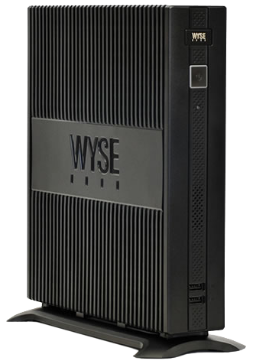
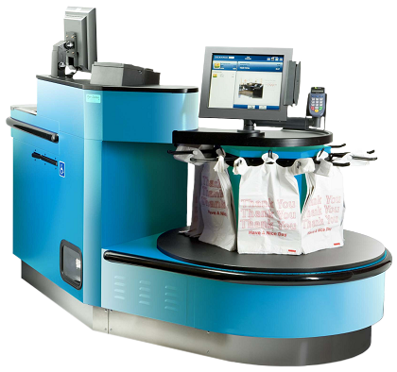
Managing security in modern Windows based Automation System environment
Windows Embedded Device Manager 2011
New product based on Microsoft System Center Configuration Manager.
Use the differential VHD to always boot from a secure image
Ask your vendor to use Windows Server Core to reduce the number of required patches by approx. 59%
Thin Client
Point Of Service
Digital Signage
Windows XP Embedded
Windows XP Embedded
Windows Embedded Standard 2009
Windows Embedded
Standard 2009
Windows Embedded for Point of Service
Windows Embedded Standard 7
Windows Embedded Standard 7
Windows Embedded POSReady 2009

Slide 17
How to benefit from Cloud Computing in securing Automation Systems
Microsoft Intune
Manage and secure PCs using Windows cloud services and Windows 7. IT staff can remotely perform a number of essential management tasks including Microsoft updates, malware protection, and inventory management so IT and end-users can remain productive from virtually anywhere.
Windows Azure and SQL Azure
CloudGUARD

Slide 18
Call to Action
Learn more about Microsoft Products
Threat Management Gateway: www.microsoft.com/tmg
SecureGUARD: www.secureguard.at
Microsoft Security Essentials (MSE): http://www.microsoft.com/security_essentials
Forefront Endpoint Protection www.microsoft.com/forefront
Microsoft Embedded: www.microsoft.com/embedded
Embedded Device Management: http://msdn.microsoft.com/en-us/library/ff769910.aspx
Windows Intune http://www.microsoft.com/windows/windowsintune/pc-management.aspx
Developing Secure Code:
Secure Development Lifecycle (SDL) on MSDN:
Secunia
www.secunia.com and
2010 half year report.
Industrial Automation
ISA 99 Website
Example Siemens Security Framework PCS7 and WinCC
http://support.automation.siemens.com/WW/view/en/22229786

Slide 19
Q&A
Questions and Answers

